Slide 1










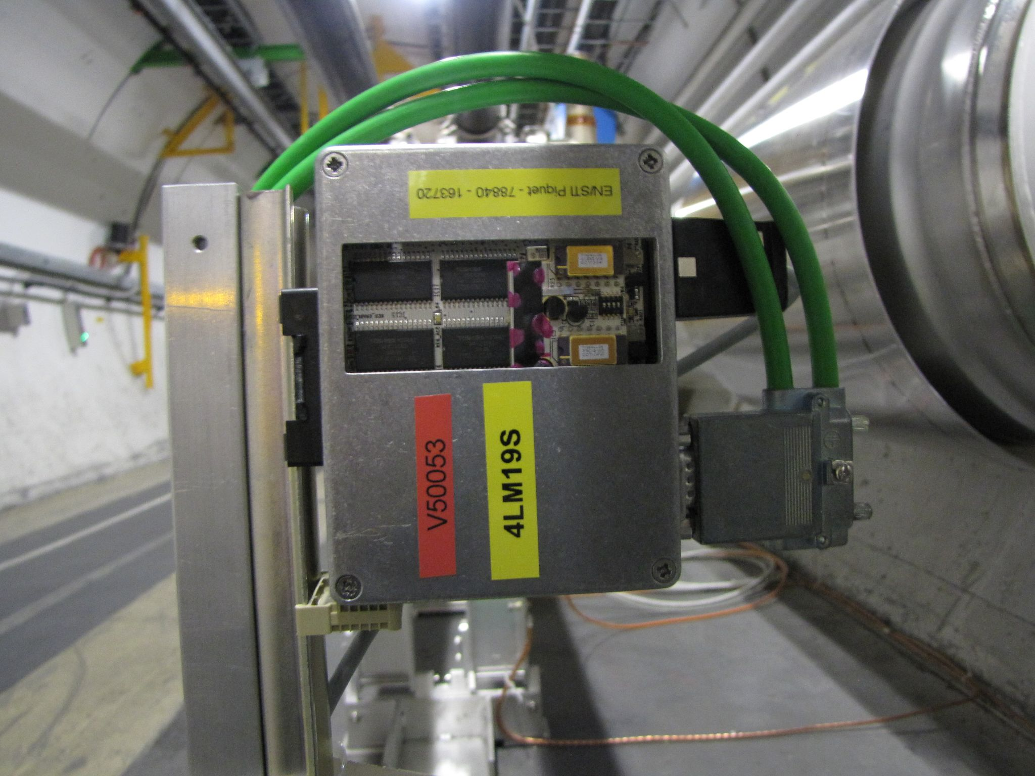
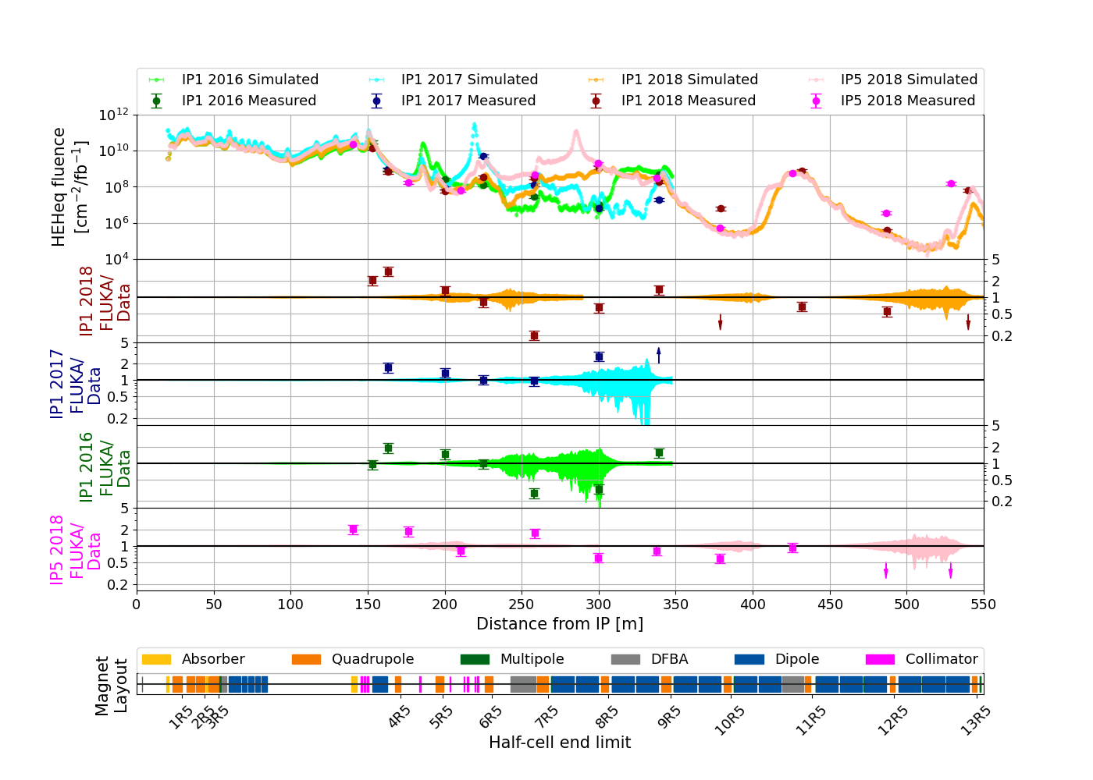

COMPARISON BETWEEN RUN 2 SEU MEASUREMENTS AND FLUKA SIMULATIONS
IN THE CERN LHC TUNNEL AND SHIELDED ALCOVES AROUND IP1/5
Daniel Prelipcean^{1,2} (daniel.prelipcean@cern.ch), Giuseppe Lerner¹, Rubén García Alía¹, Marta Sabaté Gilarte¹, Francesco Cerutti¹, Alessandro Zimmaro¹, Salvatore Danzeca¹
¹CERN (CH-1211 Geneva), ²Technical University of Munich (DE-80333 München)
1. The Large Hadron Collider (LHC)
4. Benchmark Results
The scope of this paper is to present a systematic comparison between the simulated radiation levels and those measured by radiation monitors used for Radiation to Electronics (R2E) [1, 2] applications at the LHC [3] at CERN.
The benchmark between simulated and measured data for the RadMons located in the accelerator tunnels are shown in Fig. 2, where the observed agreement of the results is considered to be generally good: the FLUKA predictions reproduce well the measured data trend and the agreement is within a factor of 2 for most RadMons. The results for the RadMons located in the shielded alcoves are presented in the paper, pointing to a slight oversimulation (35%) of the radiation levels. This is considered to be rather good, in order to be on the more cautious side when predicting radiation levels and implementing mitigation measures.
The radiation levels in the main LHC tunnel on the right side of the Interaction Point 1 (ATLAS detector) and 5 (CMS detector) are simulated using the FLUKA Monte Carlo code [4-6] and compared against Single Event Upset (SEU) measurements performed with the Radiation Monitor (RadMon) [7-8] system.
Fig. 1: RadMon detector installed in the LHC.
2. Radiation levels in luminosity-driven in IPs
The main source of radiation in the LHC tunnel in IP1 are inelastic proton-proton collisions in the center of the ATLAS experiment (𝑧 = 0 m) whose debris partially propagates in the tunnel leading to radiation showers.
The discussion in this paper deals with effects on the machine equipment electronics leading to failures in operation and accelerator downtime. The cause of Single Event Effects (SEE), such as the SEUs measured by the RadMon is the High Energy Hadron equivalent fluence (HEHeq), as simulated by FLUKA. Due to the origin of the showers, the RadMon measurements in this portion of the tunnel are assumed to scale with luminosity, which is a measure of the number of inelastic collisions taking place in the IP. Moreover, the symmetry around IP allows to reduce the study to only one side of the tunnel (e.g. right side).
3. The RadMon detector
Fig. 2: Top pannel: Comparison between RadMon data and FLUKA predictions for the tunnel in the right side of the high luminosity IPs for 3 years of Run 2 operation with different configurations, and the weighted (on the measured fluences) ratios and the standard deviation of FLUKA to measured data for each year are: for IP1 (ATLAS detector): 2018 with LSS+DS+ARC TCL456: 15s-35s-park RP: IN (red) - 1.87 ± 0.88
2017 with LSS+DS TCL456: 15s-35s-20s RP: IN (blue) and - 1.13 ± 0.65 2016 with LSS+DS TCL456: 15s-15s-open RP: OUT (green)- 0.99 ± 0.58
for IP5 (CMS detector): 2018 with LSS+DS+ARC TCL456: 15s-35s-park RP: IN (magenta) - 1.87 ± 0.71 Center pannels: The ratio of FLUKA simulated values to the RadMon measurements, with arrows indicating outliers outside the plotting range. Lower pad: Machine beamline layout, with markers at the cell limits right of IP.
In total, roughly 400 RadMons are placed in strategic locations around the LHC tunnel and its adjacent shielded areas to monitor the radiation field relevant to radiation induced failures in LHC electronics. The RadMon detectors provide measured data on the Total Ionizing Dose (TID) by means of RadFETs [9], Displacement Damage (DD) by the means of p-i-n diodes, and HEHeq (for particle energies above 20 MeV and intermediate energy neutrons) and Thermal Neutron (THN) fluences by counting SEUs of Static Random-Access Memory (SRAM) memories.
The total number of SEUs is then defined as the product of fluence (Φ, in units of cm⁻²) and cross section (𝜎, in units of cm⁻²), taking into account both HEHqe and THN as:
5. Conclusions
The main results of this study was to validate the use of simulation tools like FLUKA and their predicting power in the difficult scenario of the LHC accelerator. The general level of agreement that results from this study is a factor of 2 or better, with local outliers.
The estimated annual HEHeq levels below the beamline (where electronics racks are often located) varies due to the accelerator operation (e.g. collimator apertures), but it is in the range of [10¹¹, 10¹³] cm⁻² up to 150 m, and with local minima down to 10⁸ cm⁻² up to 350 m, assuming a total of 80 fb⁻¹ delivered LHC luminosity per year. Such levels are the highest present in the LHC tunnels, and placing equipment here requires dedicated analysis to assess the feasibility of the installation, often involving the development and qualification of radiation tolerant systems. The levels in the ARC sectors can go as low as 10⁶ cm⁻² [11].
Using precalibrated SRAM detectors with known cross sections, the RadMon can thus be employed to measure HEHeq and thermal neutron fluences.
Within the large LHC FLUKA geometry, the RadMons are not explicitly modelled (unlike the case of the BLMs [10]) due to the minuscule size of the active volume, but the HEHeq fluence is simulated in larger "equivalent"
voxels of 20x20x20 cm³ in the positions of interest. This choice is motivated as well by the fact that, unlike the TID, the hadron fluences are expected to be independent on the material and detector geometry.
References
The Radiation to Electronics (R2E) project at CERN, website. URL https://r2e.web.cern.ch/.
M. Brugger. R2E and availability. In Proc. of Workshop on LHC Performance, Chamonix, France, 2014.
O. Brüning et al. LHC Design Report. CERN Yellow Reports: Monographs. CERN, Geneva, 2004. doi:10.5170/CERN-2004-003-V-1. URL https://cds.cern.ch/record/782076.
FLUKA website. URL https://fluka.cern.
C. Ahdida et al. New Capabilities of the FLUKA Multi-Purpose Code. Frontiers in Physics, 9, 2022. ISSN 2296-424X. URL https://www.frontiersin.org/article/10.3389/fphy.2021.788253.
G. Battistoni et al. Overview of the FLUKA code. Annals Nucl. Energy, 82:10–18, 2015. doi: 10.1016/j.anucene.2014.11.007.
G. Spiezia et al. The LHC Radiation Monitoring System - RadMon. Proceedings of Science RD11 (2011). doi: 10.22323/1.143.0024.
G. Spiezia et al. A New Radmon Version for the LHC and its Injection Lines. IEEE Transactions on Nuclear Science, 61(6):3424–3431, 2014. doi: 10.1109/TNS. 2014.2365046.
Y. Aguiar et al. “Radiation to Electronics Impact on CERN LHC Operation: Run 2 Overview and HL-LHC Outlook”. In: 12th IPAC. doi:10.18429/JACoW-IPAC2021-MOPAB013.
D. Prelipcean et al. Comparison Between Run 2 TID Measurements and FLUKA Simulations in the CERN LHC Tunnel of the ATLAS Insertion Region. In: 13th IPAC. doi: 10.18429/JACoW-IPAC2022-MOPOMS042.
K. Biłko et al. Radiation Environment in the LHC Arc Sections During Run 2 and Future HL-LHC Operations. IEEE Trans. Nucl. Sci., 67(7):1682–1690, 2020. doi: 10.1109/TNS.2020.2970168.

